Slide 1
ARRAYS & SCANNER CLASS IN JAVA

Slide 2
SCANNER CLASS IN JAVA
Java User Input
it is found in the java.util package.
METHOD | DESCRIPTION
nextBoolean() | Reads a boolean value from the user
nextByte() | Reads a byte value from the user
nextDouble() | Reads a double value from the user
nextFloat() | Reads a float value from the user
nextInt() | Reads a int value from the user
nextLine() | Reads a String value from the user
nextLong() | Reads a long value from the user
nextShort() | Reads a short value from the user

Slide 3
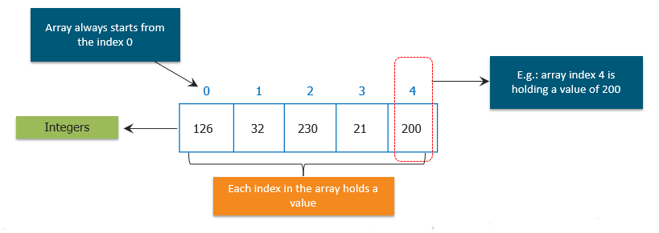
WHAT ARE JAVA ARRAYS???
Arrays are an important structure to hold data.
Java allows us to hold many objects of the same type using arrays.
It can be used with the help of a loop to access the elements by their index.

Slide 4
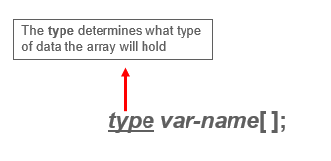
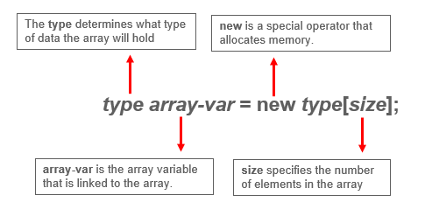
General Form of Java Array Initialization
Example:- int month_days[];
General Form of
Java Array
Initialization

Slide 5
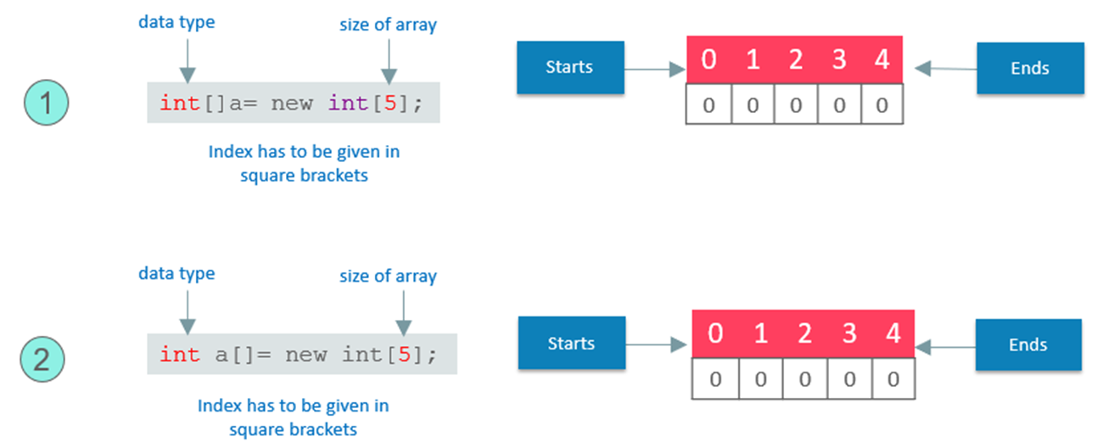
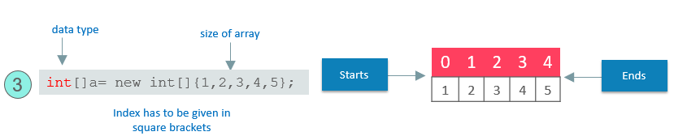
Example:

Slide 6
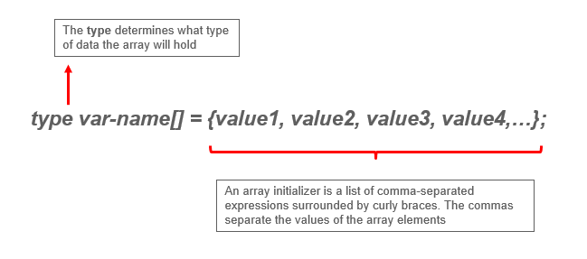
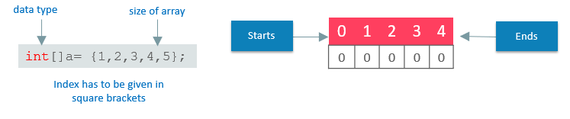
General Form of Java Array Initialization

Slide 7
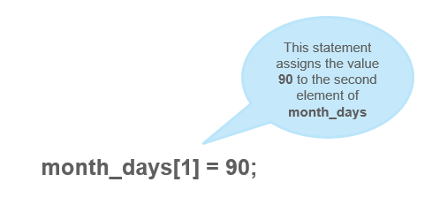
Accessing a Specific Element in a Java Array
In arrays, we can access the specific element by its index within square brackets.

Slide 8
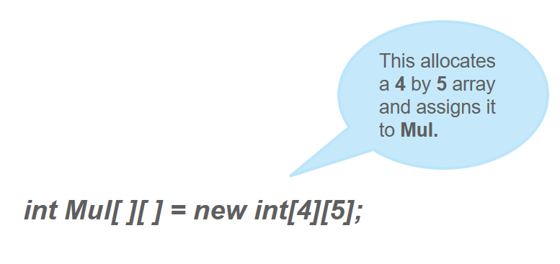
JAVA MULTIDIMENSIONAL ARRAY
Multidimensional arrays are arrays of arrays
Declaring Multidimensional Array : specify each additional index using another set of square brackets.

Slide 9
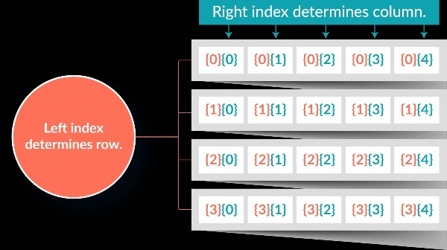
Array declared above would be represented as shown in the figure:-

Slide 10
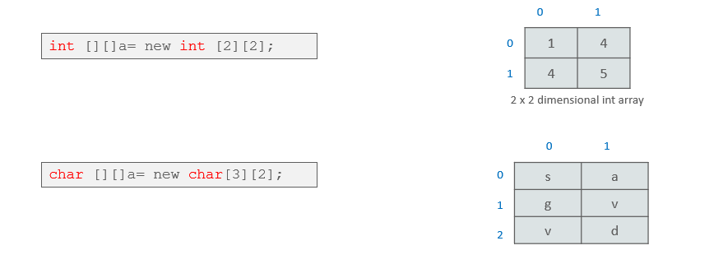
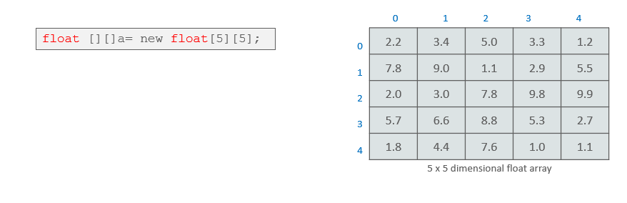
Multidimensional arrays representation of other data types.

Slide 11
PASSING JAVA ARRAY TO A METHOD
We can also pass arrays to methods just as we can pass primitive type values to methods.
Example :
public class PMethods{
public static void display(int y[])
{
System.out.println(y[0]);
System.out.println(y[1]);
System.out.println(y[2]);
}
public static void main(String args[])
{
int x[] = { 1, 2, 3 };
display(x);
}
}
Output : 1
2
3

